Slide 1

Ethical Hacking

Slide 2
Disclaimer
I’m not an expert in security.
I’m not an expert in hacking.
I’m not an expert.

Slide 3
Agenda
What is Ethical Hacking?
Most common attacks
Ethical Hacking Challenge
Debriefing and solution

Slide 4
Ethical Hacking – What is it?
An ethical hacker is a computer and networking expert who systematically attempts to penetrate a computer system or network on behalf of its owners for the purpose of finding security vulnerabilities that a malicious hacker could potentially exploit.

Slide 5
Ethical Hacking – Who should be concerned?
Anyone developing anything exposed to any network.

Slide 6
Most common attacks
Phising
Denial Of Service
Brute Force
Session Hijacking
URL Interpretation
Injections
XSS
CSRF

Slide 7
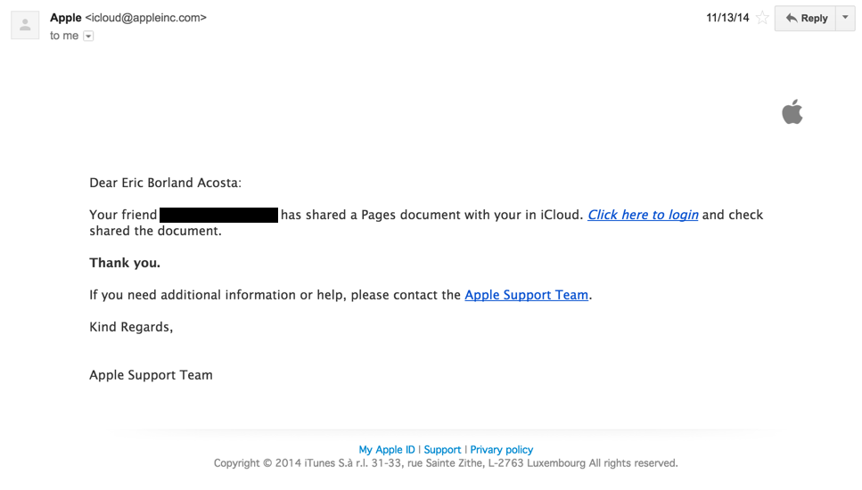
Phishing

Slide 8
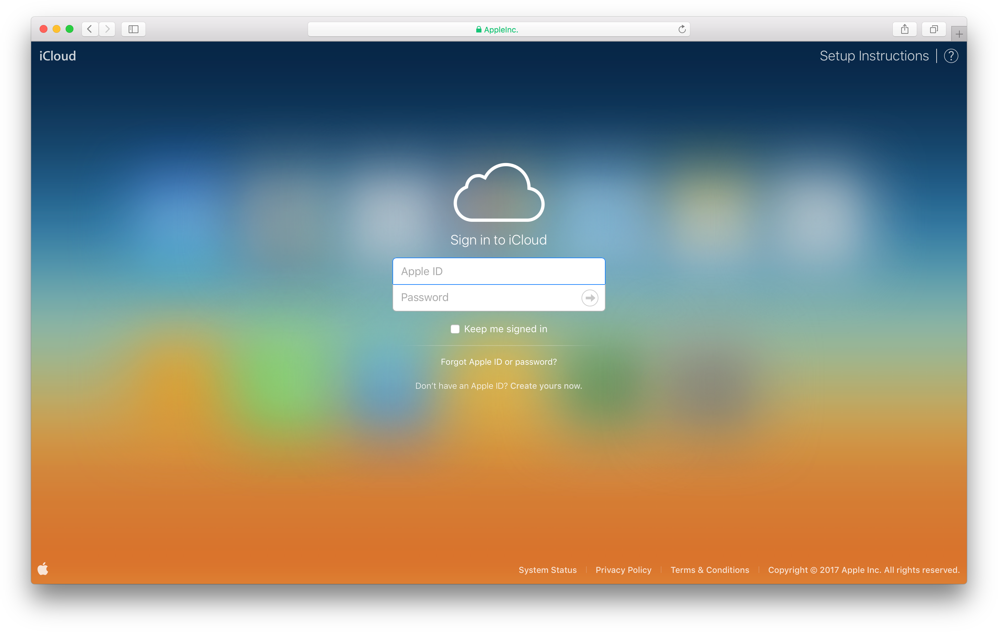
Phishing

Slide 9
Phishing
Almost impossible to avoid
It’s mostly a users’ fault but it’ll be seen as a security issue in your app
Avoid emails with links and educate your users (SSL, Signed emails…)
Password expiration

Slide 10
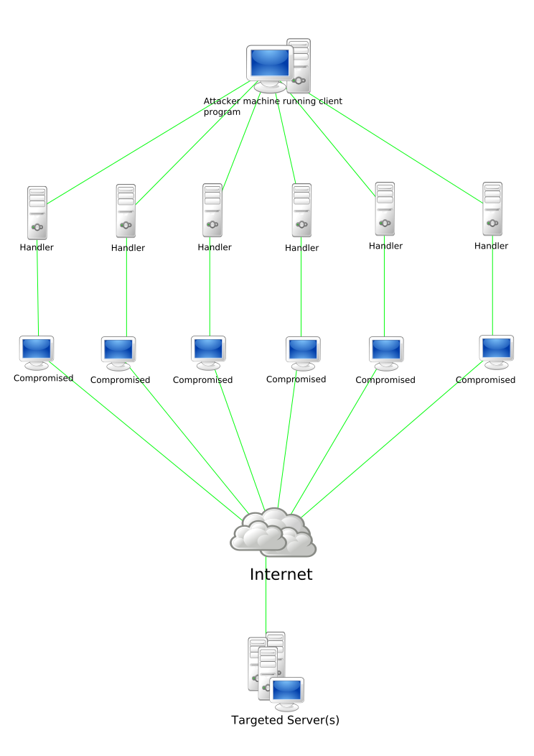
Denial Of Service
$150
You can buy a DDoS attach
+2000
DDoS attacks are observed every day
30%
Of attacks are DoS
Degradation of service
Distributed DoS
HTTP POST DoS
ICMP Flood
Slow Read attack
…

Slide 11
Denial Of Service - Defense
Application Firewalls
IP-based prevention
Request Timeouts
…

Slide 12
Brute Force

Slide 13
Brute Force
Trial and error
Username/password
Encrypted data

Slide 14
Brute Force
Top 10 most used passwords:
123456
123456789
qwerty
12345678
111111
1234567890
1234567
password
123123
987654321

Slide 15
Brute Force
Many services uses a 4-digit password:
0000 – 9999: 10000 possibilities
Average (or maximum) login response time: < 0.2s
Brutal force attack: <33.4min

Slide 16
Brute Force - Defense
Do NOT allow easy passwords: combination of numbers, uppercase and lowercase letters are mandatory.
Ban multiple login requests on the same username
Ban multiple login request from the same IP
Invalidate passwords when necessary
Track your user’s location, IP and user agent

Slide 17
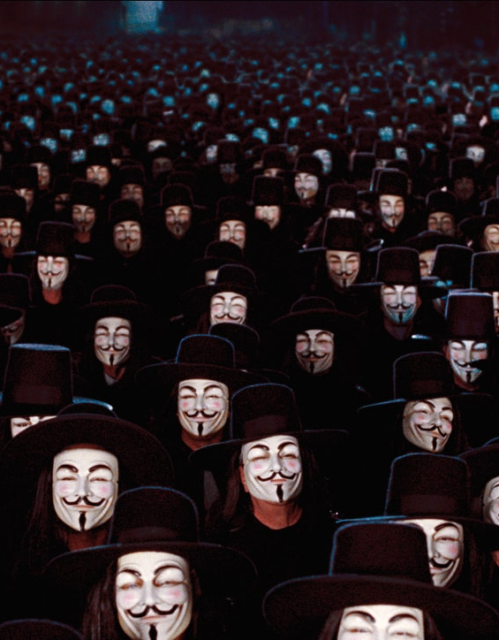
Session Hijacking
Sniffing
HTTPS, Hotspots, Public networks, remember me…
Session only depends on HTTP Headers / Cookies
Poor mechanism and XSS vulnerable.
Session fixation

Slide 18
Session Hijacking - Defense
Mandatory HTTPS
Do not accept session id from POST or GET
New SID on login. Renew SID periodically.
HTTP Only session cookie (to avoid XSS)
Match session with other info: User agent, location, IP…
Session expiration
Logout is important

Slide 19
URL Interpretation
APP Interpretation
GET /user/email@example.com/info
GET /user-picture/58fa5a128e9185013e75417d
Info headers
<intput disabled=“true” value=“50”/>
If (form.isValid()) { //perform } else { //reject }
Client only side validation or limitation

Slide 20
URL Interpretation - Defense
Avoid parameters in requests
Always use Server-side validation
Don’t rely on disabled or hidden inputs or parts of the DOM
The less information, the better

Slide 21

Injections
Close to XSS
SQL Injection
Other queries Injection
Code Injection
File Injections
Log Injections
Command Injections

Slide 22
Injections – SQL Injection
function login(req, res) {
const email: req.body.email;
const password: hash(req.body.password);
const query = ‘SELECT * FROM users WHERE email=" ‘ + email +
‘" AND password=" ‘ + password + ‘;’;
}
curl -H "Content-Type: application/json"
-X POST
-d '{"username":"email@example.com","password":"\" OR 1=1"} '
http://localhost:3000/api/login

Slide 23
Injections – SQL Injection
function login(req, res) {
const email: req.body.email;
const password: hash(req.body.password);
const query = ‘SELECT * FROM users WHERE email=" ‘ + email +
‘" AND password=" ‘ + password + ‘;’;
}
username = email@example.com
password = " OR 1=1
RESULT:
query = ‘SELECT * FROM users WHERE email=email@example.com AND password="" OR 1=1’

Slide 24
Injections – Log injections
logger.log(‘User logged in as ‘ + req.session.user.name);
user.name = ‘Robert\nUser logged in as Admin\nAdmin added $150 budget to campain with id 1234567’
RESULT:
[info.log]
User logged in as Robert
User logged in as Admin
Admin added $150 budget to campaign with id 1234567

Slide 25
Injections – Defense
User data is by default untrusted
Never use, eval, parse, execute or compile untrusted data
Sanitize params, urls, htmls…
Avoid string concatenation
Use db driver’s params mechanism

Slide 26
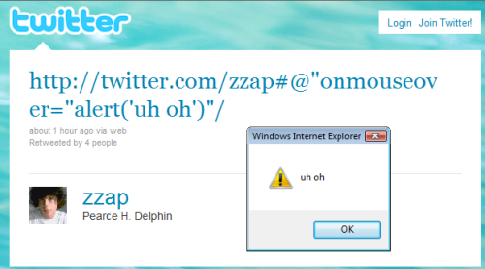
XSS
http://twitter.com/zzap#@"onmouseover="alert('uh oh')"/

Slide 27
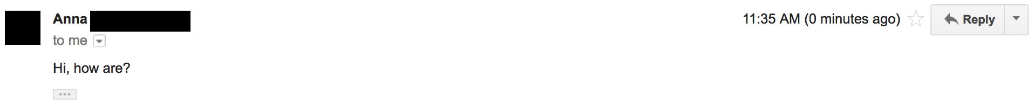
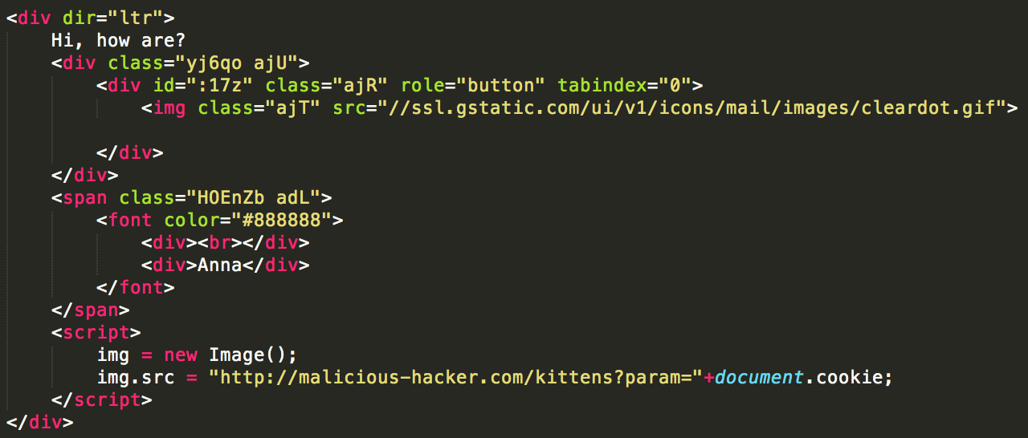
XSS

Slide 28
XSS - Defense
HTTP Only cookies
Validation
Sanitize params, urls, htmls, javascripts…
Modern browsers, frameworks, libraries...

Slide 29
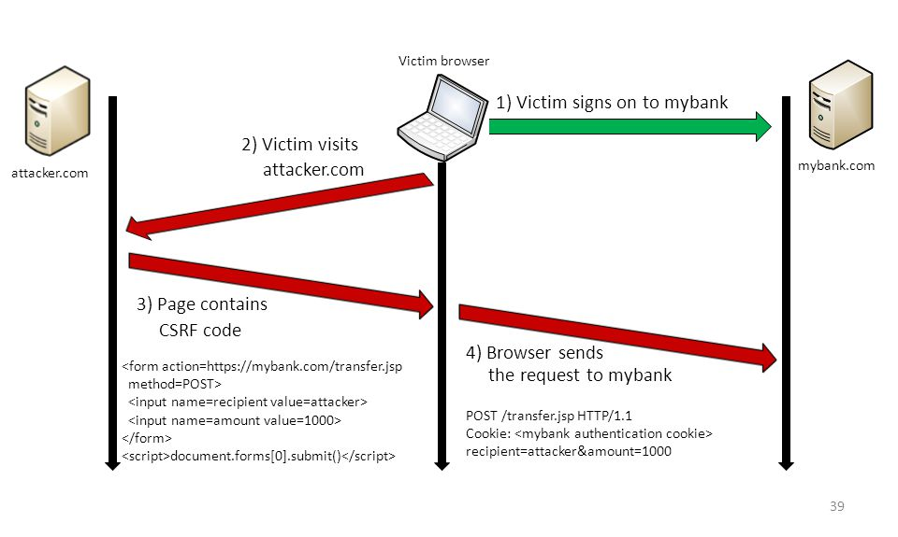
CSRF
Could require XSS
Vulnerable Cross-Origin Resource Sharing (CORS) rules
Access-Control-Allow-Origin: *

Slide 30
CSRF - Defense
Avoid Access-Control-Allow-Origin: *
Avoid Access-Control-Allow-Origin: req.headers.origin
Require password for important operations
Serve the site through the API
Always check the origin, the referer and the host headers
Use Sync CSRF tokens
Guard libraries

Slide 31
Ethical Hacking
Challenge
Be imaginative
Any piece of information could be valuable
Trial and error

Slide 32
Ethical Hacking
Challenge
Get info about frameworks, architectures, libraries used
Crash the server
Get users’ personal data
Get users’ sessions
Obtain plain-text passwords
Tweak DB queries
Get DB access
Get the code
Get server access
Steal money!
…

Slide 33
Thank You!
https://github.com/eBorland/bank-hacking

